Slide 1
Electronic Devices
Mid Term Lecture - 07
Faculty Name: Dr. Md. Kabiruzzaman
Email : kabiruzzaman@aiub.edu
Reference book:
Electronic Devices and Circuit Theory (Chapter-3)
Robert L. Boylestad and L. Nashelsky , (11th Edition)

Slide 2
Objectives
Become familiar with the basic construction and operation of the Bipolar Junction Transistor.
Be able to apply the proper biasing to insure operation in the active region.
Recognize and be able to explain the characteristics of a npn or pnp transistor.
Become familiar with the important parameters that define the response of a transistor.
Be able to test a transistor and identify the three terminals.

Slide 3
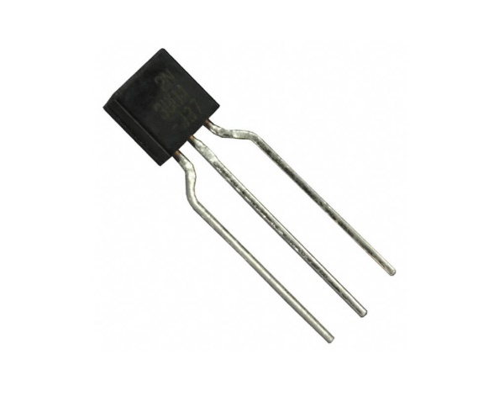
INTRODUCTION
The basic of electronic system nowadays is semiconductor device.
The famous and commonly use of this device is BJTs (Bipolar Junction Transistors).
It can be used as amplifier and logic switches.
BJT consists of three terminal:
collector : C (Lightly Doped)
base : B (Very lightly doped)
emitter : E (Heavily doped)
Two types of BJT : p-n-p and n-p-n

Slide 4
TRANSISTOR CONSTRUCTION
3 layer semiconductor device consisting:
two n- and one p-type layers of material = n-p-n transistor
two p- and one n-type layers of material = p-n-p transistor
The term bipolar reflects the fact that holes and electrons participate in the injection process into the oppositely polarized material.
A single p-n junction has two different types of bias:
forward bias
reverse bias
Thus, a two-p-n-junction device has four types of bias.

Slide 5
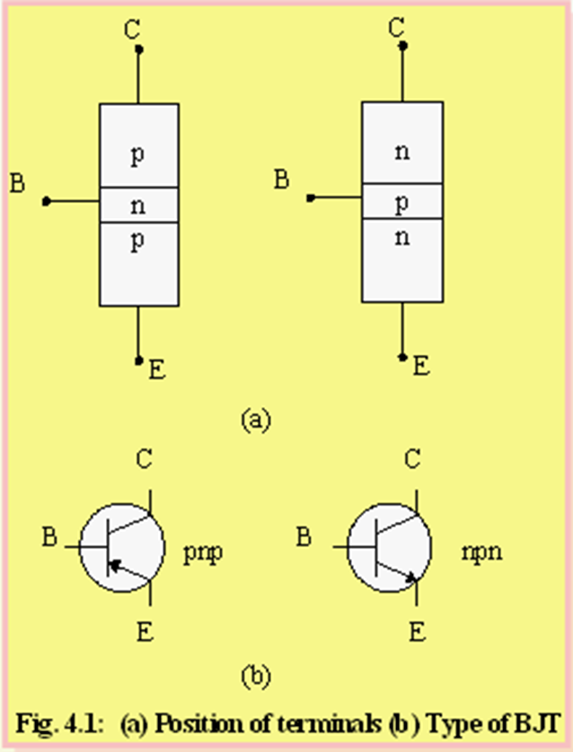
POSITION OF THE TERMINALS AND SYMBOL OF BJT
Base is located at the middle and more thin from the level of collector and emitter.
The emitter and collector terminals are made of the same type of semiconductor material, while the base of the other type of material.

Slide 6
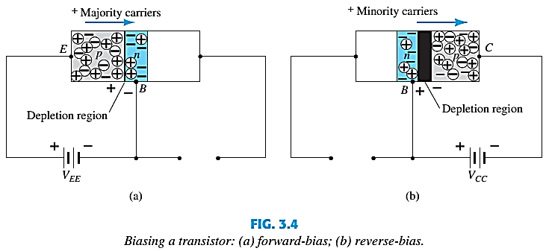
TRANSISTOR OPERATION
The basic operation will be described using the p-n-p transistor.
The operation of the n-p-n transistor is exactly the same if the roles played by the electron and hole are interchanged.
One p-n junction of a transistor is reverse-biased, whereas the other is forward-biased.

Slide 7
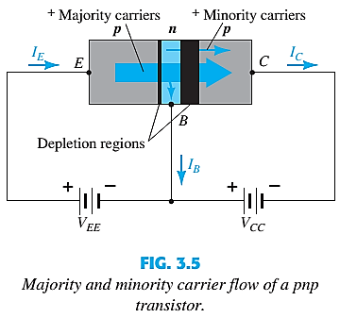
TRANSISTOR OPERATION
Both biasing potentials have been applied to a p-n-p transistor and resulting majority and minority carrier flows indicated.
Majority carriers (+) will diffuse across the forward-biased p-n junction into the n-type material.
A very small number of carriers (+) will go through n-type material to the base terminal. Resulting I_{B} is typically in order of microamperes.
The large number of majority carriers will diffuse across the reverse-biased junction into the p-type material connected to the collector terminal.

Slide 8


TRANSISTOR OPERATION
Majority carriers can cross the reverse-biased junction because the injected majority carriers will appear as minority carriers in the n-type material.
Applying KCL to the transistor :
The collector current comprises of two components – the majority and minority carriers
I_{CO} = I_{C} current with emitter terminal open and is called leakage current.

Slide 9
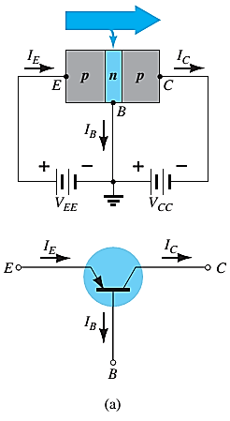
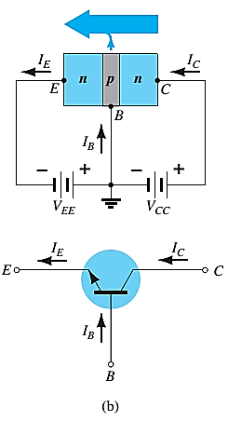
COMMON-BASE CONFIGURATION
Common-base terminology is derived from the fact that the :
- base is common to both input and output of the configuration.
- base is usually the terminal closest to or at ground potential.
All current directions will refer to conventional (hole) flow and the arrows in all electronic symbols have a direction defined by this convention.
Note that the applied biasing (voltage sources) are such as to establish current in the direction indicated for each branch.

Slide 10
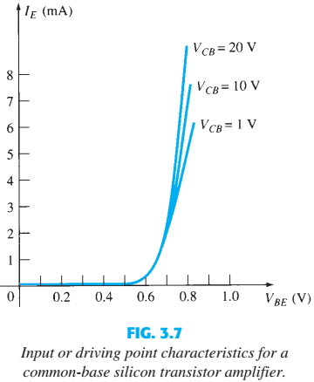
COMMON-BASE CONFIGURATION
To describe the behavior of common-base amplifiers requires two set of characteristics:
Input or driving point characteristics.
Output or collector characteristics

Slide 11
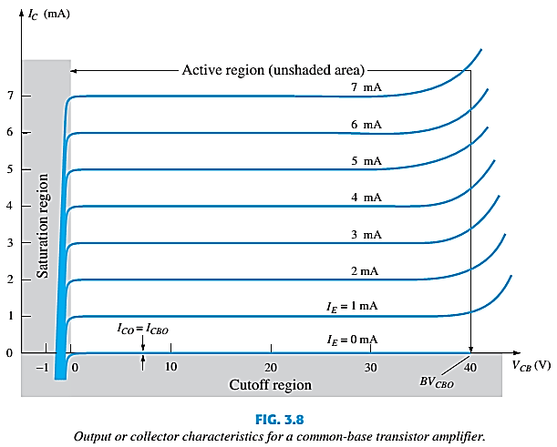
COMMON-BASE CONFIGURATION
The output characteristics has 3 basic regions:
Active region – defined by the biasing arrangements
Cutoff region – region where the collector current is 0A
Saturation region- region of the characteristics to the left of V_{CB} = 0V

Slide 12
COMMON-BASE CONFIGURATION
ACTIVE REGION | SATURATION REGION | CUTOFF REGION
I_{E} increased, I_{C} increased
BE junction reverse biased and CB junction reverse biased | BE and CB junctions are forward biased | BE and CB junction are reverse biased
I_{C} ≈ I_{E} |  | No current flow at collector, only leakage current
I_{C} does not depend on V_{CB} | Small change in V_{CB} will cause big difference in I_{C}
Suitable region for the transistor to work as an amplifier | The allocation for this region is to the left of the V_{CB} = 0 V | Region below the line of I_{E} = 0

Slide 13
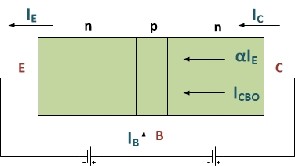
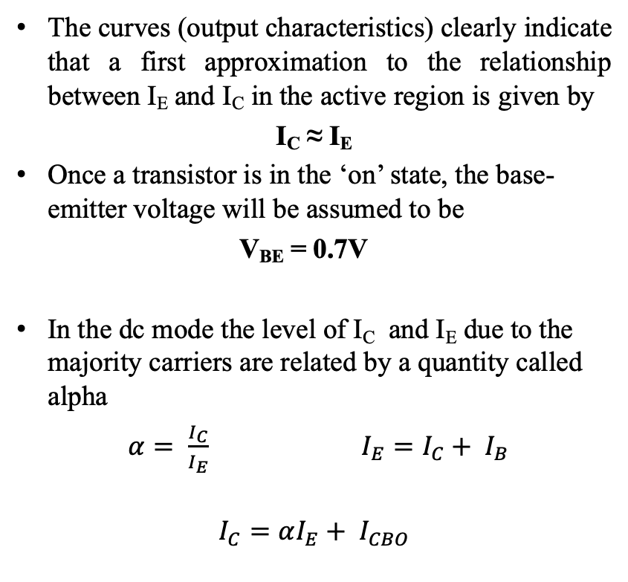
COMMON-BASE CONFIGURATION
The curves (output characteristics) clearly indicate that a first approximation to the relationship between I_{E} and I_{C} in the active region is given by
I_{C} ≈ I_{E}
Once a transistor is in the ‘on’ state, the base-emitter voltage will be assumed to be
V_{BE} = 0.7V
In the dc mode the level of I_{C} and I_{E} due to the majority carriers are related by a quantity called alpha
$α= \frac{I_{C}}{I_{E}}$ $I_{E}=I_{C}+ I_{B}$
$$I_{C}=αI_{E}+ I_{CBO}$$

Slide 14
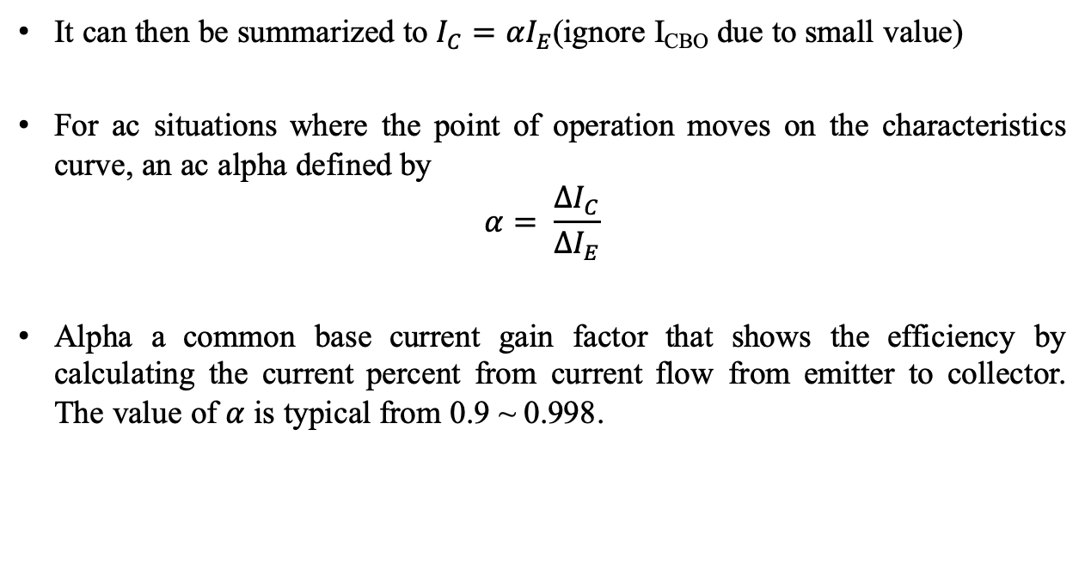
COMMON-BASE CONFIGURATION
It can then be summarized to $I_{C}=αI_{E}$(ignore I_{CBO} due to small value)
For ac situations where the point of operation moves on the characteristics curve, an ac alpha defined by
$$α= \frac{{∆I}_{C}}{{∆I}_{E}}$$
Alpha a common base current gain factor that shows the efficiency by calculating the current percent from current flow from emitter to collector. The value of $α$ is typical from 0.9 ~ 0.998.

Slide 15
Thank You

